Slide 1
City of Fort Bragg
Vacant Parcels for Housing
>.5 acres
Prepared by:
Marie Jones Consulting
July, 2023

Slide 2
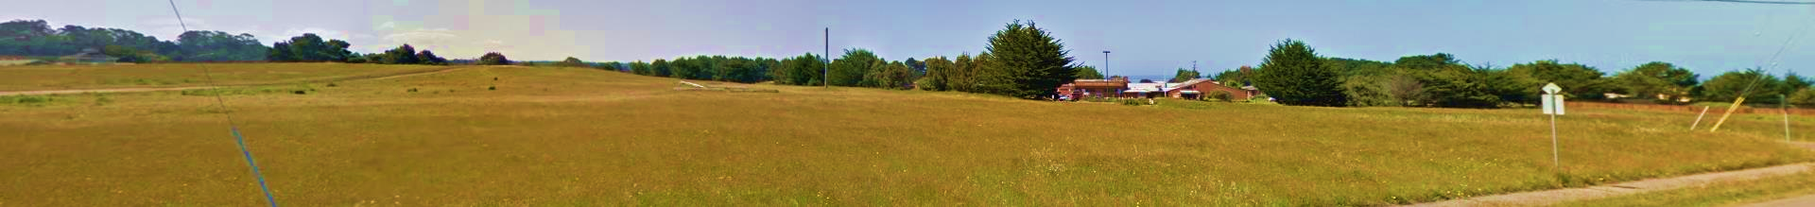
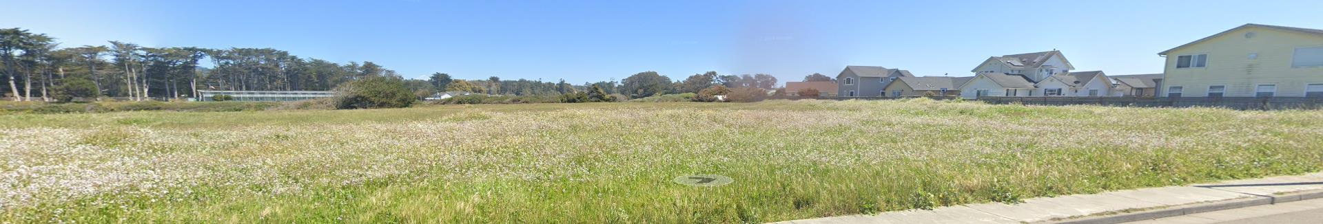
Find the right parcel for your residential project.
Location & Parcel Size
Zoning & Permitting Requirements
Maximum and Realistic Units/Acre
Known Constraints
For information purposes only. Review project files and talk to a planner prior to making an offer for a property.

Slide 3
Planning Process
Applicant Completes Relevant Studies: Botanical, Wetland, Visual, Geotechnical
Prepare Architectural Schematics: Site Plan, Floor Plan, Elevations, Landscaping Plan, Lighting Plan
Meet with City to Discuss Your Project
Apply for Permits with Complete Submittal: all studies & architectural schematics
City will start CEQA process if needed: Initial Study, followed by an ND, MND or EIR
City will request Public Agency Comments
City Staff will prepare CEQA document and Staff Report
Planning Commission Hearing
If in Coastal Zone, Notice of Final Action to Coastal Commission
If no appeal, permit issued within 10 business days

Slide 4
Project Costs & Timing
Fees for Planning Permits & CEQA, 6 months to 1 year
Consultant Fees for Studies, Reports & Architectural Drawings, 6 months to 1 year
Construction Drawings & Building Permit Fees, 6-9 months
Sewer & Water Capacity Fees and Connection Costs, Stormwater Fee, 1 week
Construction Costs, 1 to 2 years
Property Acquisition, 3-6 months

Slide 5
Info & Resources
Density & Intensity of Development
The total allowable units may be constrained by:
  Requirements for parking, landscaping, and other site requirements; and
  Site constraints such as wetlands, rare plants, visual corridors, archaeological resources, etc.
Total allowable units may be increased as follows:
  The State requires 2 additional detached ADUs for all multi-family projects, and one ADU and one Junior ADU for each dwelling unit in a subdivision; and
  Affordable and inclusionary housing requirements can result in a significant density bonus.
Permitting Information
All multifamily projects require a Use Permit & Design Review, all Coastal Zone projects require a Coastal Development Permit.
  Citywide Design Guidelines https://www.city.fortbragg.com/home/showpublisheddocument/3324/637890863791570000
  Multi-Family Specific Land Use Standards:
  Coastal: https://www.codepublishing.com/CA/FortBragg/#!/LUC17/FortBraggLUC174/FortBraggLUC1742.html#17.42.120
  Inland: https://www.codepublishing.com/CA/FortBragg/#!/LUC18/FortBraggLUC184/FortBraggLUC1842.html#18.42.120
All multifamily projects require review under CEQA through either a Negative Declaration (ND), Mitigated Negative Declaration (MND) or Environmental Impact Report (EIR). Some affordable housing projects may be exempt from CEQA.
Coastal Development Permits are administered through the City of Fort Bragg; however, some projects may be appealable to the California Coastal Commission.

Slide 6
Coastal Zone Parcels
>.5 acres
Parcels in the Coastal Zone are generally more difficult to develop.
Resource studies always required: botanical study, wetland study, archaeological study.
Resource Studies sometimes required: visual analysis, traffic analysis, geotechnical analysis.
Coastal Development Permit, Use Permit are Design Review Permit always required.
Projects are appealable to the City Council and the Coastal Commission, although appeals are rare.
Plan on a 6 month to a year or more planning process depending on project complexity.
Some of the City’s nicest and largest vacant parcels are in the Coastal Zone.

Slide 7
Coastal Zone
Properties @ a Glance
South to North In the Coastal Zone

Slide 8
Coastal Zone
Properties @ a Glance
South to North In the Coastal Zone

Slide 9
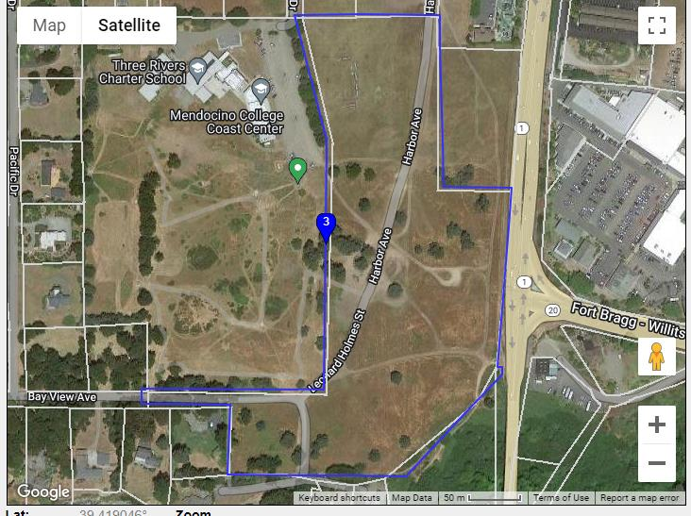
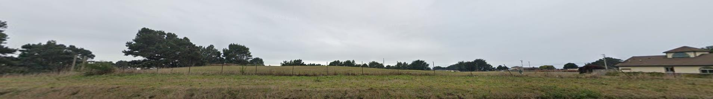
PROPERTY – 1250 Del Mar Dr.
Zoning & Permitting Requirements
Parcel Size Dimensions, Parcel Map
Split Zoned. Max development it 351 units + 2 ADUs.
  9 acres of Visitor Serving Commercial 24 units per acre; 216 units.
  9 acres of High Density Residential 15 Units per acre; 135 units.
Coastal Zone – Coastal Development Permit & Use Permit Required.
Information
  Botanical reports completed in mid 2010s, no botanical issues identified.
  Visual Impact Analysis required.
  Traffic study required, known capacity issues on Ocean View Drive, no other access possible to parcel per Caltrans.
  Expect significant community opposition unless the project is well designed with minimal visual impacts.
  Project will likely require an EIR.
18 acres

Slide 10
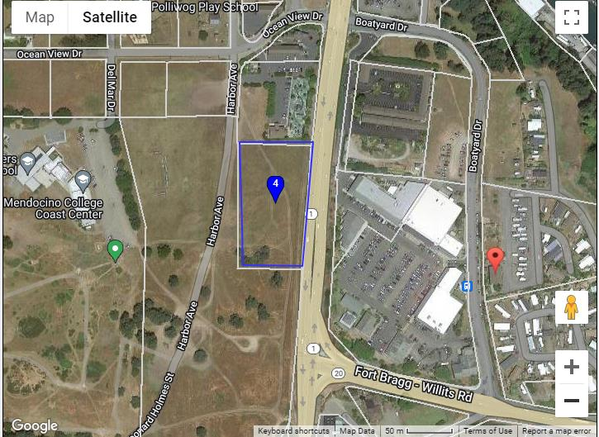
PROPERTY – 1250 Del Mar Dr. #2.
Zoning & Permitting Requirements
Parcel Size Dimensions, Parcel Map
2.5 acres of Visitor Serving Commercial 24 units per acre; 60 + 2 units.
Coastal Zone – Coastal Development Permit & Use Permit Required.
Information
  Botanical reports completed in mid 2010s, no botanical issues identified.
  Visual Impact Analysis required.
  Access off Ocean Drive, potential capacity issues
  Expect significant community opposition unless the project is well designed with minimal visual impacts.
  Project will likely require an MND.
2.5 acres

Slide 11
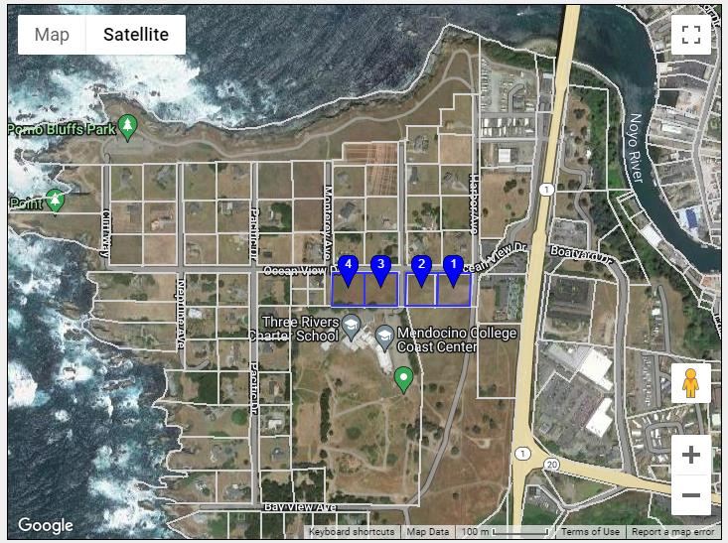
PROPERTY – 300, 350, 250 & 200 Ocean View Dr
Zoning & Permitting Requirements
Parcel Size Dimensions, Parcel Map
4 acres of Medium Density Residential; 6-12 units/acre, 48 +2 units max.
Coastal Zone – Coastal Development Permit & Use Permit Required.
Information
  Botanical report completed and no botanical issues identified.
  Visual impact analysis required.
  Adjacent to community college.
4 parcels
@ 0.9 acres each

Slide 12
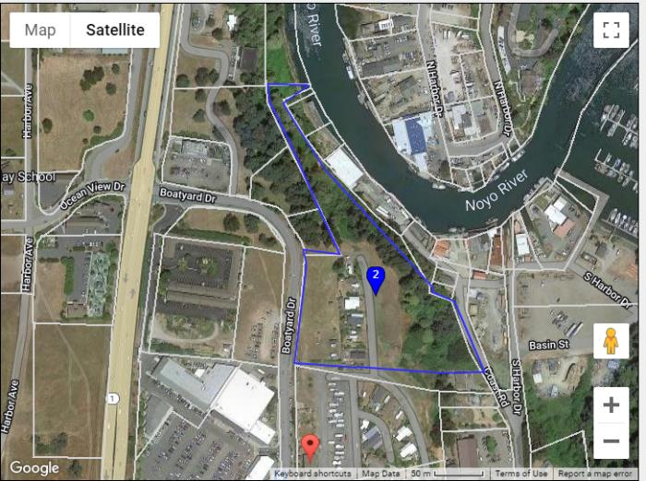
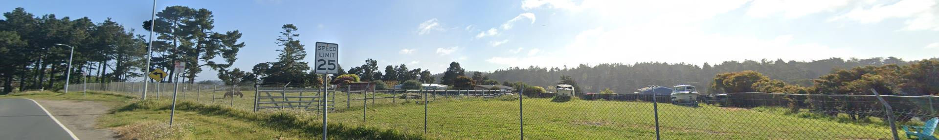
PROPERTY – 180 Boatyard Drive.
Zoning & Permitting Requirements
Parcel Size Dimensions, Parcel Map
3 developable acres of Very High Density Residential @ 24 units/acre; 72 + 2 units.
Coastal Zone – Coastal Development Permit & Use Permit Required.
Information
  About half of this parcel is developable.
  Parcel has an existing small mobile home park.
  Visual Impact Analysis, Botanical Study and Wetland delineation would be required.
5.8 acres

Slide 13
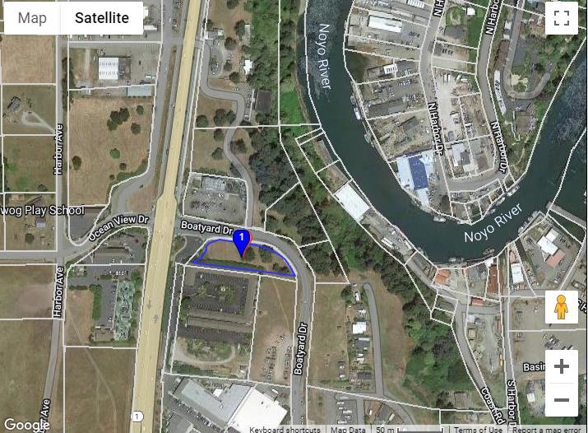
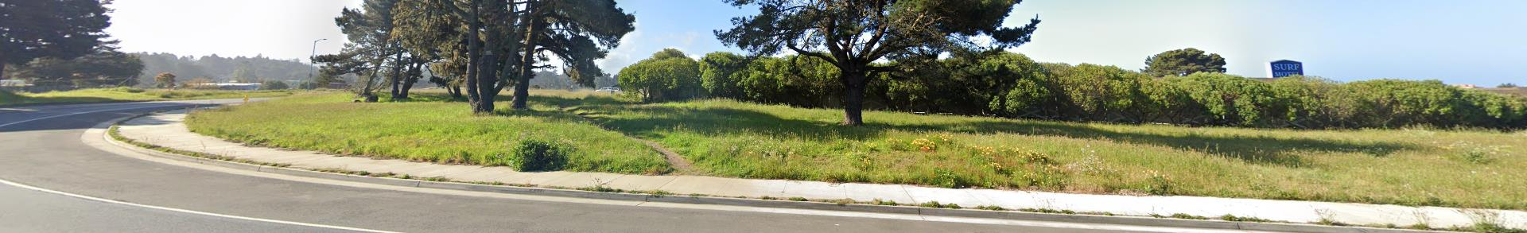
PROPERTY – 100 E Oceanview Dr.
Zoning & Permitting Requirements
Parcel Size Dimensions, Parcel Map
0.7 acres of Visitor Serving Commercial 24 units per acre; 17 + 2 units.
Coastal Zone – Coastal Development Permit & Use Permit Required.
Information
  Archeology Study and Botanical Study would be required.
  ND or MND would be required.
0.7 acres

Slide 14
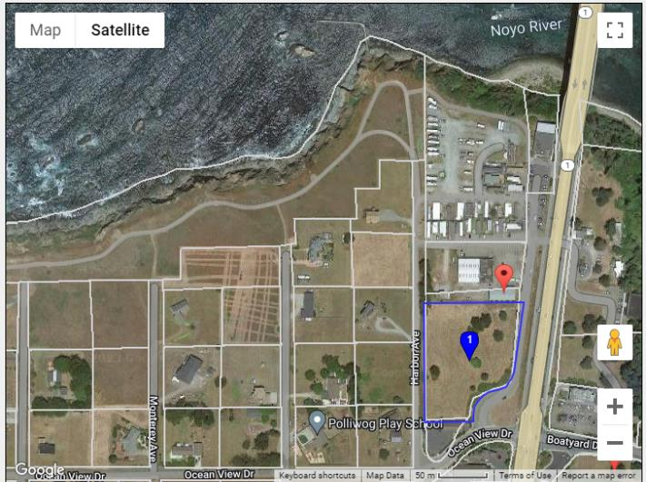
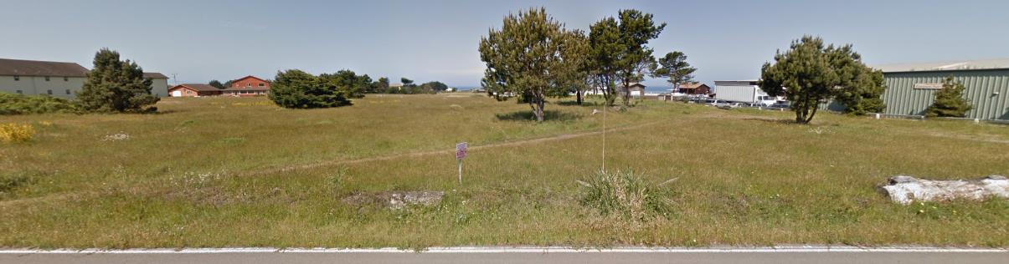
PROPERTY – 1151 S Main Street.
Zoning & Permitting Requirements
Parcel Size Dimensions, Parcel Map
2.6 acres of Visitor Serving Commercial, 24 units/acre; 62 + 2 units.
Coastal Zone – Coastal Development Permit & Use Permit Required.
Information
  Visual Impact Analysis, Botanical Study would be required.
  Arch Study has been completed.
  Site has known visual constraints.
  Sidewalks required.
  An MND would be required.
2.6 acres

Slide 15
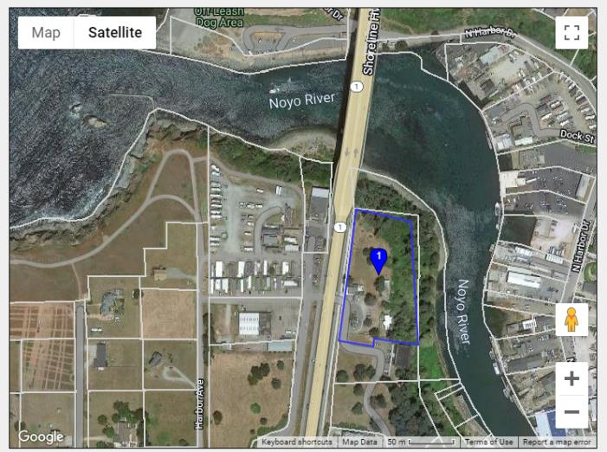
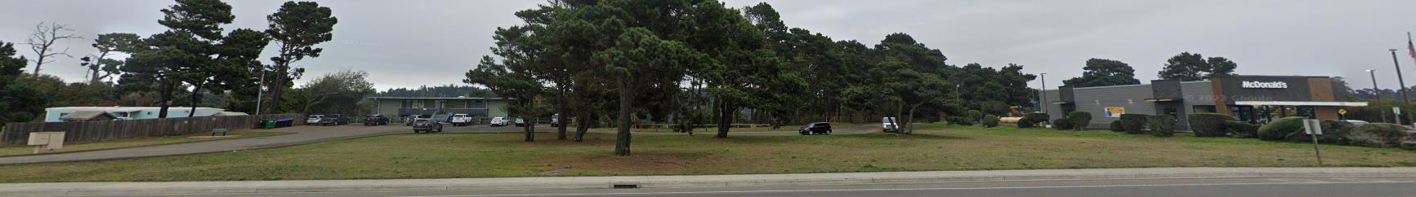
PROPERTY – 1190 S Main Street.
Zoning & Permitting Requirements
Parcel Size Dimensions, Parcel Map
  3.1 acres of Highway Visitor Commercial, 24 units per acre; 74 + 2 units.
  Coastal Zone – Coastal Development Permit & Use Permit Required.
Information
  Visual Impact Analysis, Botanical Study would be required.
  Arch Study has been completed.
  Site has known constraints, coastal resources, rare trees & slope.
  An MND would be required.
3.1 acres

Slide 16
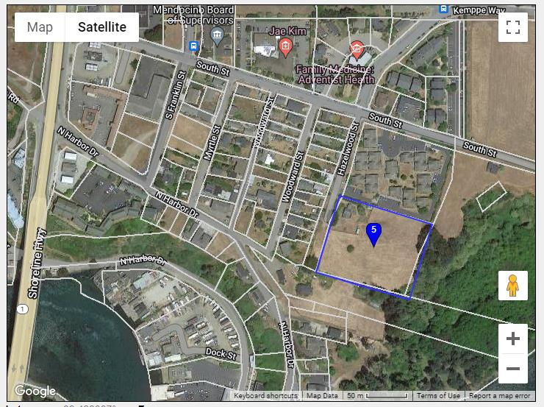
PROPERTY – 860 Hazelwood St.
Zoning & Permitting Requirements
Parcel Size Dimensions, Parcel Map
3 acres of High Density Residential 10-15 units/acre, 45 units max.
Coastal Zone – Coastal Development Permit & Use Permit Required.
Information
  Botanical reports completed and no botanical issues identified.
  Street improvements required.
  Some drainage issues on the south-east portion of the site.
3 acres

Slide 17
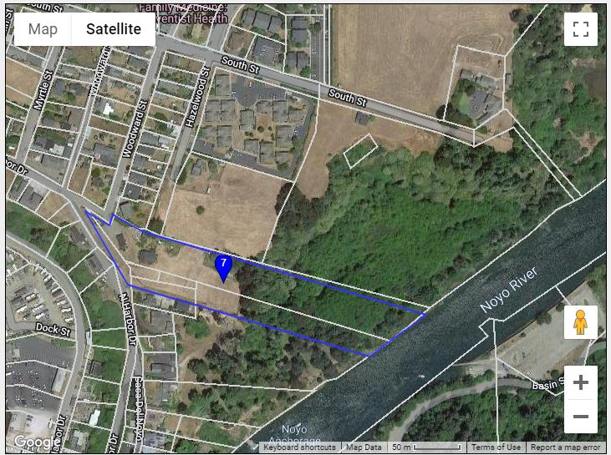
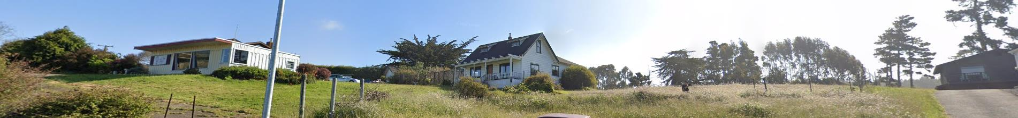
PROPERTY – 401 N Harbor Dr.
Zoning & Permitting Requirements
Parcel Size Dimensions, Parcel Map
~5 acre of Very High Density Residential 24 units per acre; Max 120 + 2 units.
Coastal Zone – Coastal Development Permit & Use Permit Required.
Information
  About half of this parcel is developable.
  Visual Impact Analysis, Botanical Study and Wetland delineation would be required.
5.1 acres

Slide 18
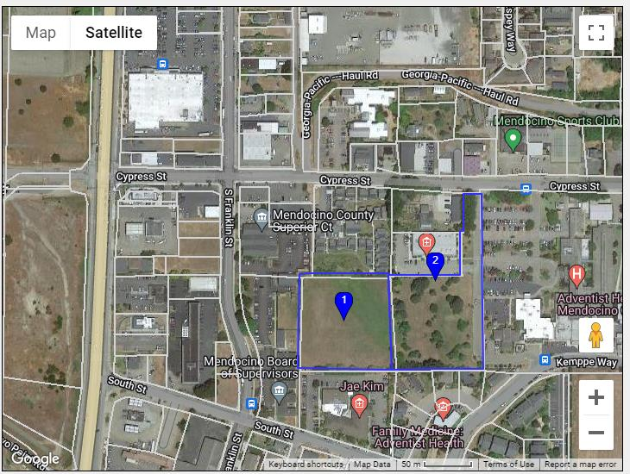
PROPERTY – 700 River Street.
Zoning & Permitting Requirements
Parcel Size Dimensions, Parcel Map
2.49 acres Office Commercial 24 units per acre; 60 + 2 units.
2.79 acres Office Commercial 24 units per acre; 66 units +2
Coastal Zone – Coastal Development Permit & Use Permit Required.
Information
  Botanical Study & Wetland Delineation would be required.
  Parcel #2 likely has some wetlands.
  Arch Study has been completed.
5.28 acres

Slide 19
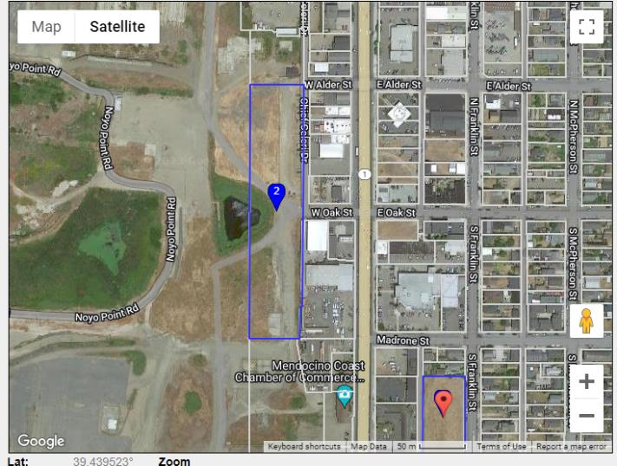
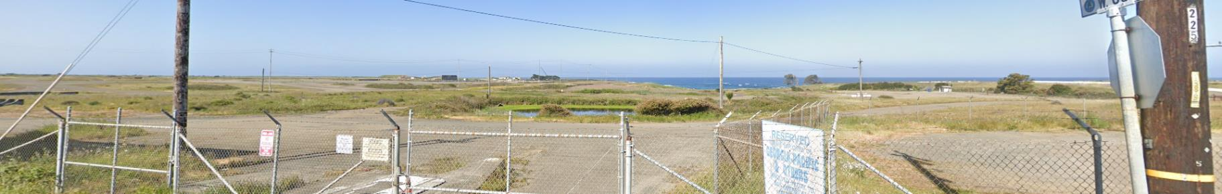
PROPERTY – 320 S Main St.
Zoning & Permitting Requirements
Parcel Size Dimensions, Parcel Map
4 acres of Central Business District. 40 units/acre. Max 160+ 2 units.
Coastal Zone – Coastal Development Permit & Use Permit Required.
Information
  40%+ of the parcel is undevelopable.
  Parcel has known existing wetland and biological resources. Mandatory 100-foot setback from wetland.
  Visual Impact Analysis, Botanical Study and Wetland Delineation would be required.
  Anticipate an MND/EIR for a project on this site.
4 acres

Slide 20
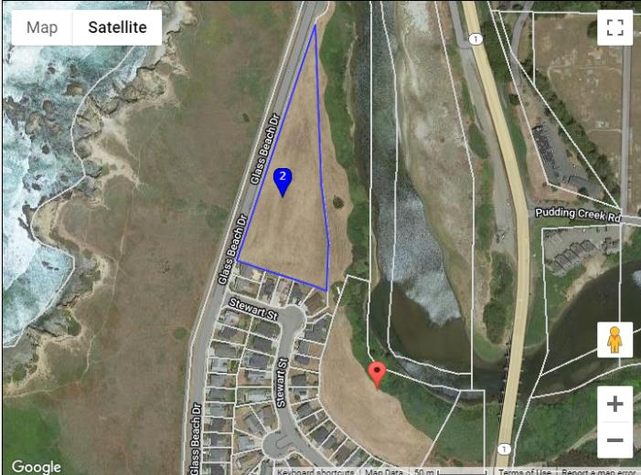
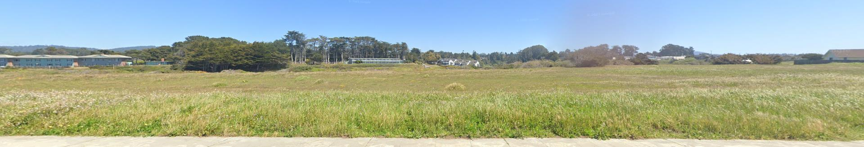
PROPERTY – 1020 Glass Beach Drive.
Zoning & Permitting Requirements
Parcel Size Dimensions, Parcel Map
Split Zoned: 2.5 acres of High Density Residential 24 units per acre.
Coastal Zone – Coastal Development Permit & Use Permit Required.
Information
  A significant portion of this parcel is undevelopable.
  Parcel has known existing biological resources. Mandatory 100 foot blufftop setback.
  Visual Impact Analysis, Botanical Study and Wetland delineation would be required.
  Anticipate an EIR for a project on this site.
3.5 acres

Slide 21
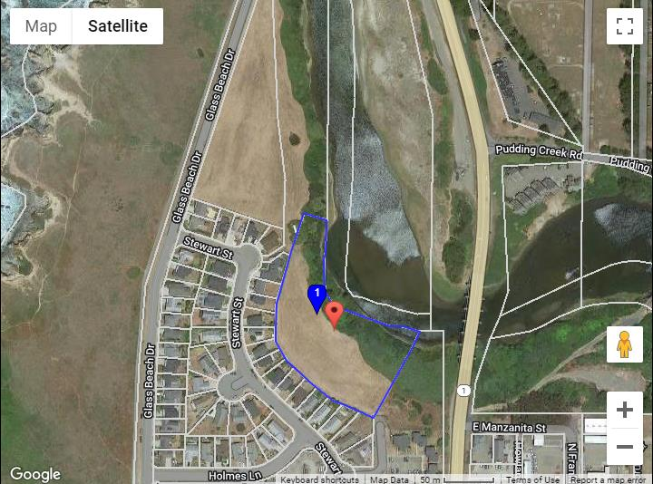
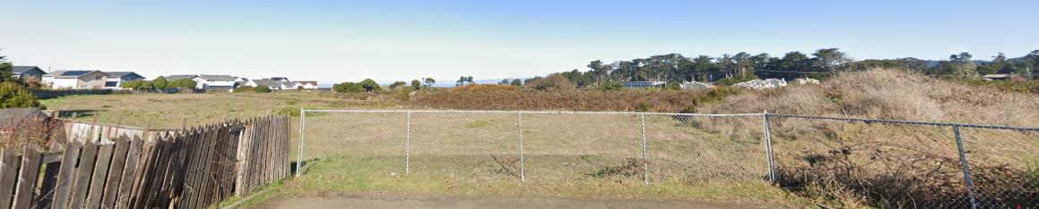
PROPERTY – 920 Steward Street.
Zoning & Permitting Requirements
Parcel Size Dimensions, Parcel Map
3.5 acres of Very High Density Residential 24 units per acre; 84 + 2 units.
Coastal Zone – Coastal Development Permit & Use Permit Required.
Information
  About half of this parcel is undevelopable.
  Parcel has known biological resources. Mandatory 100-foot setback from the bluff edge.
  Visual Impact Analysis, Botanical Study and Wetland delineation would be required.
  Anticipate an MND/EIR for a project on this site.
3.5 acres

Slide 22
Inland Zone Parcels
>.5 acres
Parcels in the Inland Zone are generally easier to develop.
Resource studies that are sometimes required include: botanical study, wetland study, archaeological study, traffic analysis, geotechnical analysis.
Use Permit & Design Review Permit typically required.
Projects are appealable to the City Council, appeals are rare.
Plan on a 3-month to 1-year planning process depending on project complexity.
2023

Slide 23
Inland Area
Properties @ a Glance
South to North In the Inland Zone

Slide 24
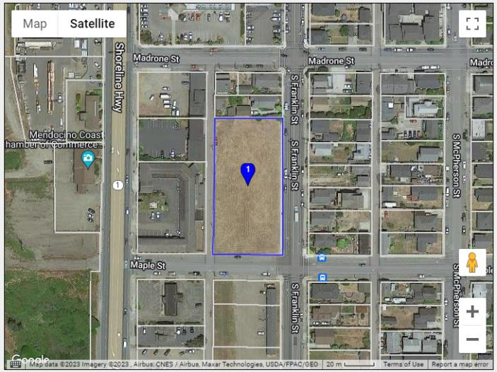
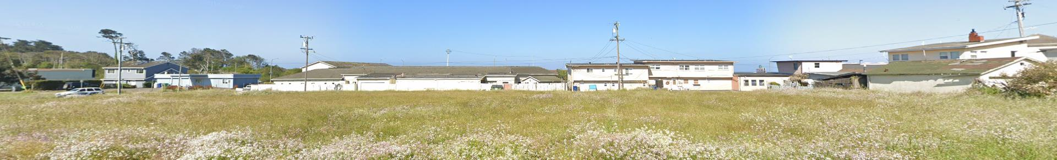
PROPERTY – 251 S Franklin Street
Zoning & Permitting Requirements
Parcel Size Dimensions, Parcel Map
  1 acre of General Commercial @ 24 units/acre; Max 24+2 units.
  Use Permit required
Information
  No known issues.
1 acre

Slide 25
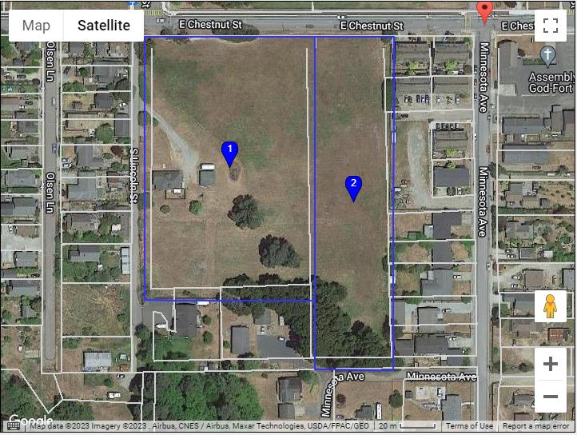
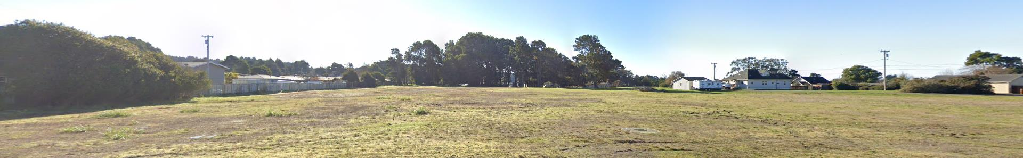
PROPERTY – 970 E Chestnut & 553 S Lincoln
Zoning & Permitting Requirements
Parcel Size Dimensions, Parcel Map
Split Zoned. 119 units
  ~ 4 acres of High Density Residential; 60+2 units
  ~ 1.8 acres of Low Density Residential; 19 primary units, 19 ADUs and 19 JADUs with subdivision.
  Use Permit & Design Review required.
Information
  Parcel may have some wetland issues; a wetland delineation would be required.
5.8 acres

Slide 26
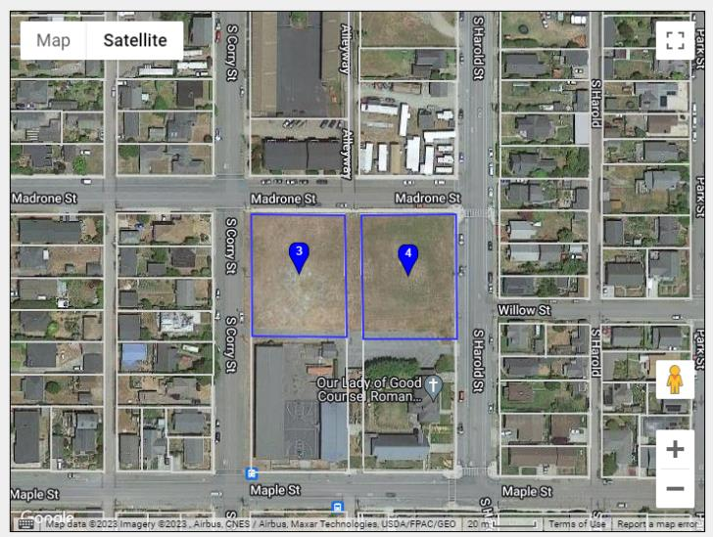
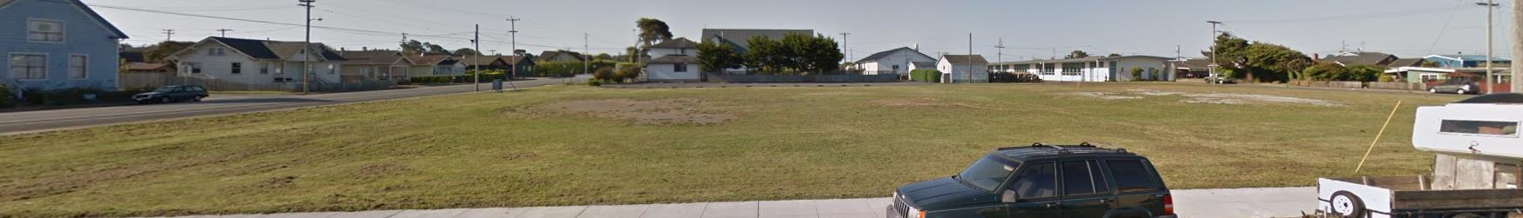
PROPERTY – 255 HAROLD ST & 605 MAPLE ST
Zoning & Permitting Requirements
Parcel Size Dimensions, Parcel Map
  1.3 acres of Public Facilities; Residential Care Facility
  Use Permit required
Information
  No known issues.
1.3 acres

Slide 27
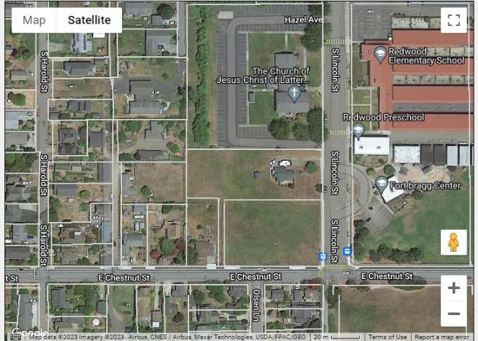
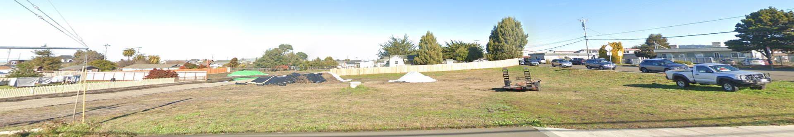
PROPERTY – 475 Lincoln Street
Zoning & Permitting Requirements
Parcel Size Dimensions, Parcel Map
  1.68 acres of Low Density Residential, with subdivision maximum development would be 10 primary units, 10 ADUs and 10 JADUs.
  Subdivision, Use Permit, Design Review Permit required.
Information
  No known issues.
  Sidewalk, curb and gutter installed.
1.68 acres

Slide 28
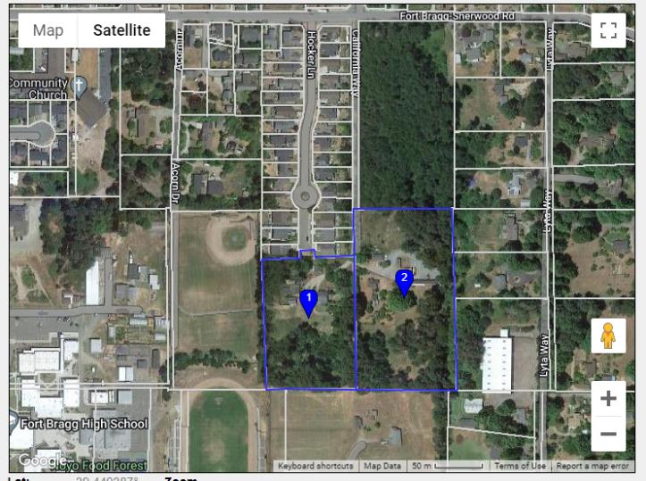
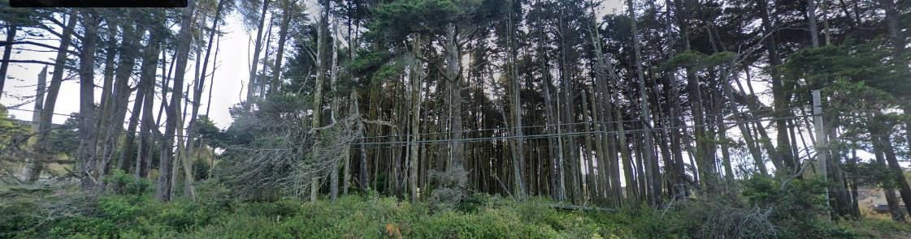
PROPERTY – 101 California Way & 31451 Sherwood RD
Zoning & Permitting Requirements
Parcel Size Dimensions, Parcel Map
8.5 acres of Low Density Residential, with subdivision max development would be 51 primary units, 51 ADUs and 51 JADUs.
Subdivision, Use Permit & Design Review required.
Information
  Possible rare tree community, botanical study required.
  Street, sidewalk, curb and gutter required.
8.5 acres

Slide 29
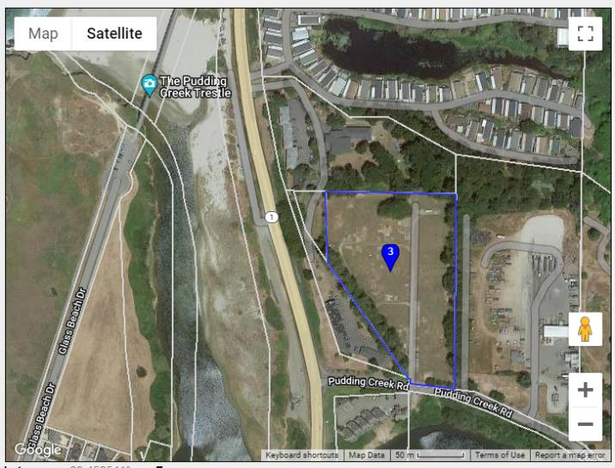
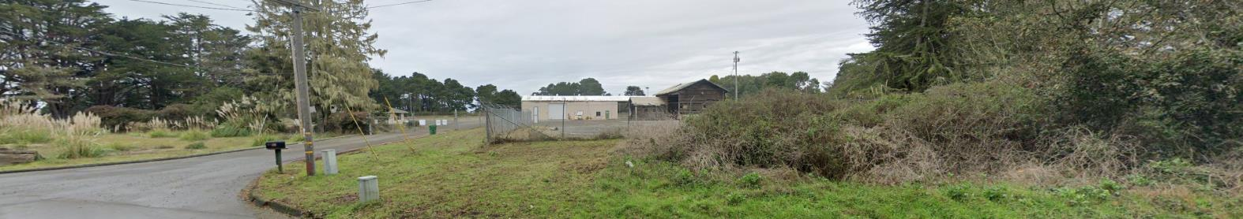
PROPERTY – 211 PUDDING CREEK RD
Zoning & Permitting Requirements
Parcel Size Dimensions, Parcel Map
Public Facilities & Services. Residential Care Facility, Emergency/Transitional Housing.
Use Permit & Design Review Required.
Parcel could be rezoned to residential use with a zoning amendment.
Information
  Parcel was formerly used for a transfer station; Phase 1 environmental would be required.
  Botanical study required.
5.76 acres

Slide 30

For More Information
Community Development Dept.
707-961-2827 ext. 112
Public Works Department
(707) 961-2823 ext. 136
Planning Permits
CEQA Analysis
Building Permits
Water and Sewer Hook Ups
Street and Sidewalk improvements
Stormwater Management

